Slide 1
Automated Machine Learning (AutoML) in Power BI
Hector Villafuerte

Slide 2
Hector Villafuerte
Business Intelligence Solutions Architect Professional
Microsoft Certified Technology Specialist, SQL, Dynamics CRM - MCTS
Works with SQL Server, Excel, Power BI, SSIS, SSAS, SSRS, SharePoint, Dynamics CRM and Azure PAAS.
Microsoft Certified Professional Developer – MCPD
Full-stack .NET Developer and Web Applications Architect.
Reach me at:
hectorvmail@gmail.com

Slide 3
Agenda
Introduction to AutoML
Build a Machine Learning model in Power BI
Create a dataflow with the input data
Create and train a machine learning model
Review the model validation report
Apply the model to a dataflow entity
Using the scored output from the model in a Power BI report

Slide 4
Introduction to AutoML

Slide 5
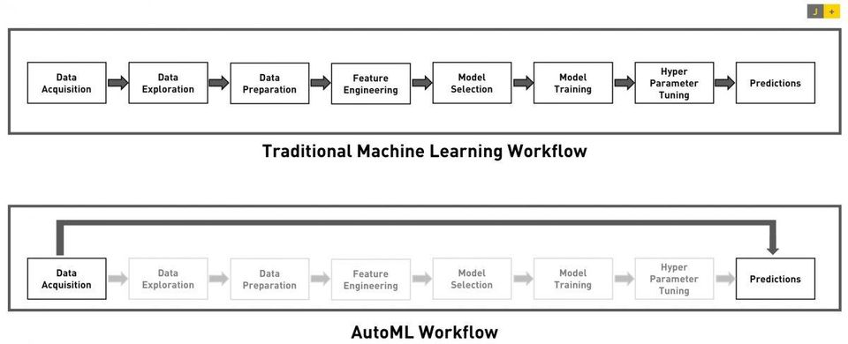
AutoML: Automated machine learning
Source: https://www.forbes.com/sites/janakirammsv/2018/04/15/why-automl-is-set-to-become-the-future-of-artificial-intelligence/#41a18f23780a

Slide 6
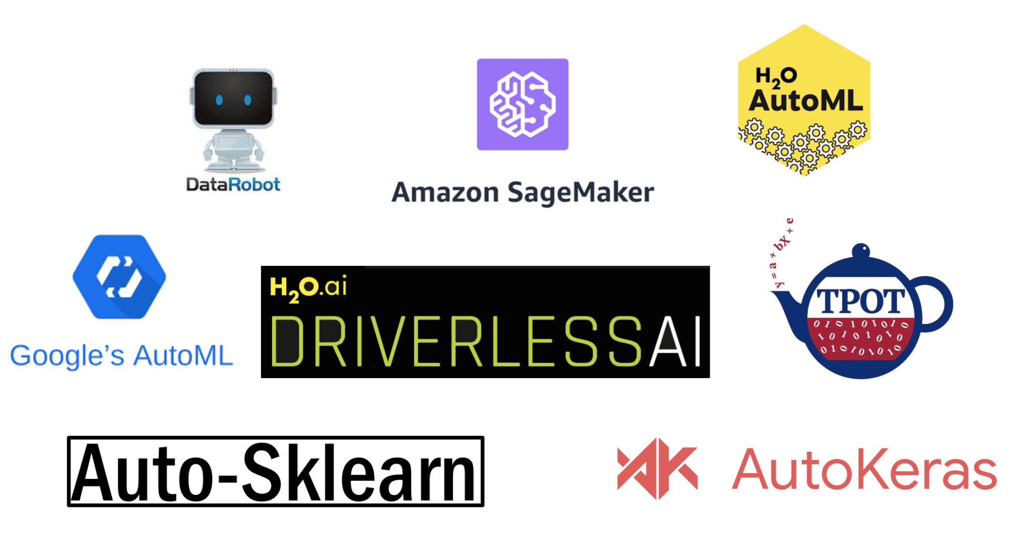


AutoML supported

Slide 7
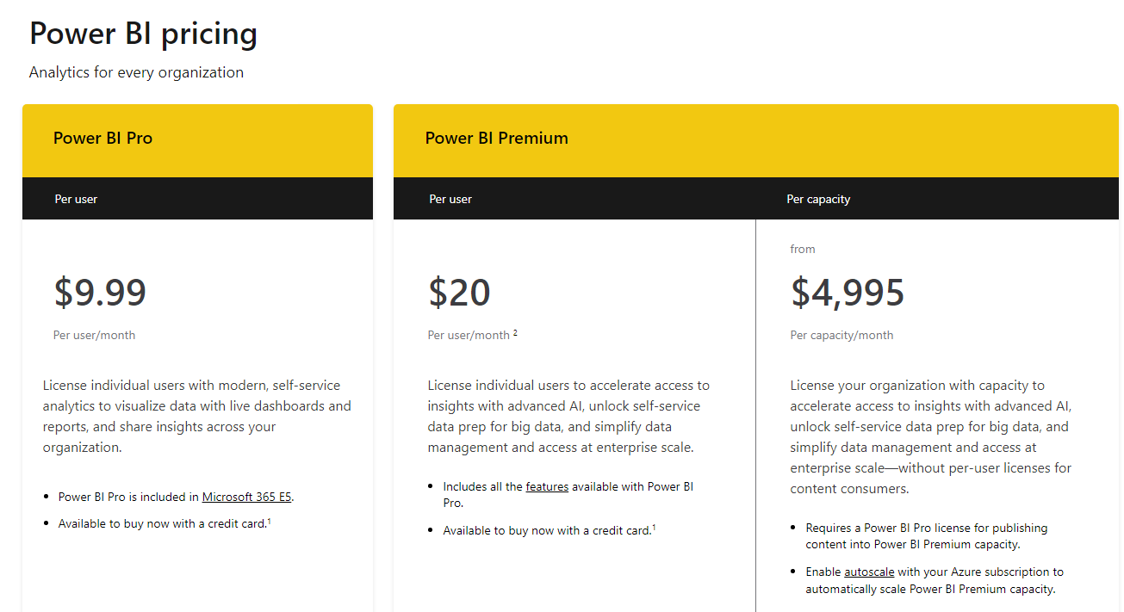
Prices updated on 2/9/2023

Slide 8
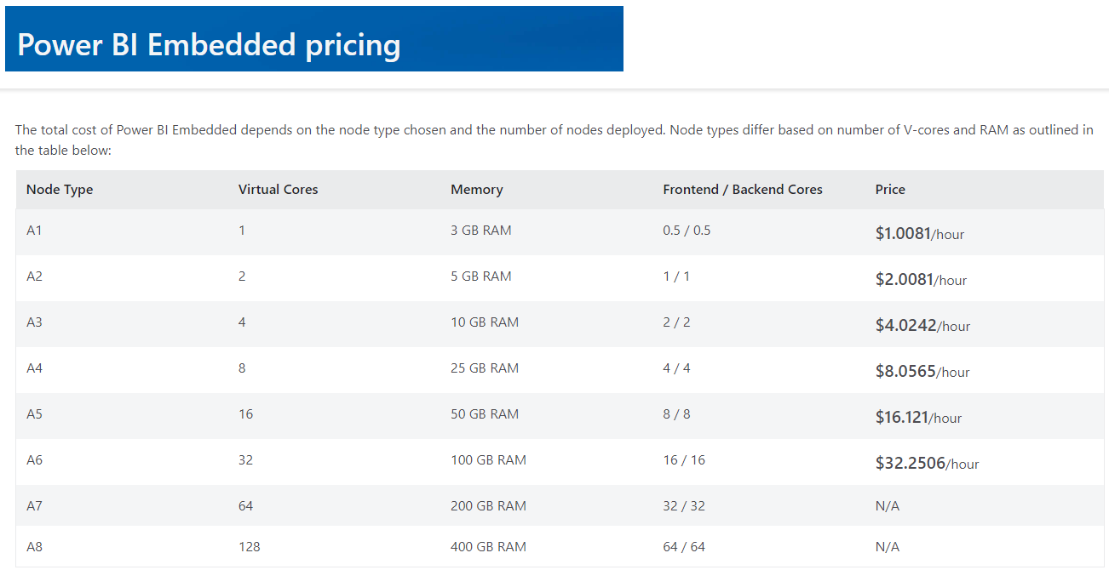
Prices updated on 2/9/2023

Slide 9
Power BI – Auto ML Binary Classification DEMO

Slide 10
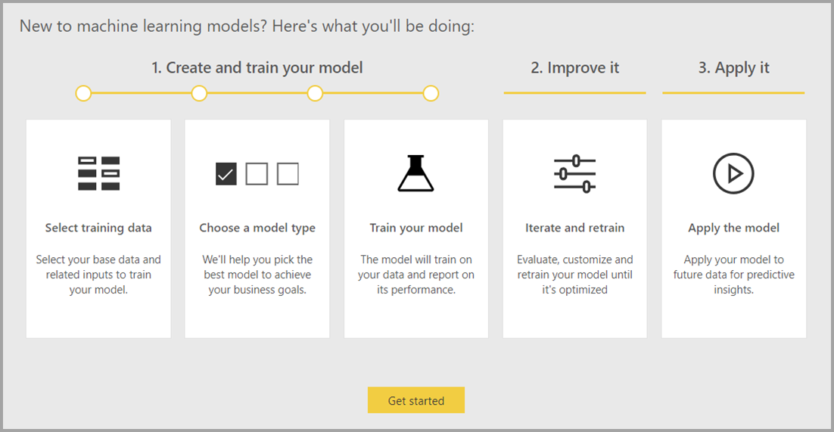

Slide 11
ML performance metrics

Slide 12
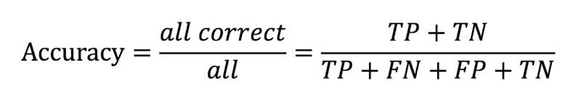
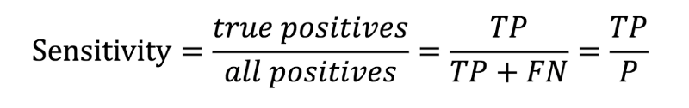
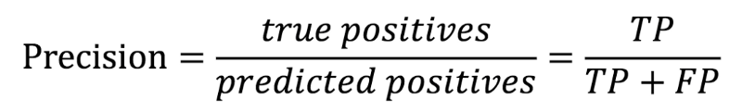
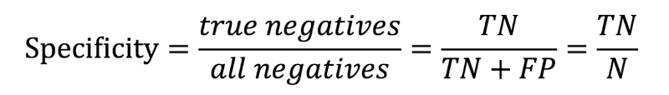
Confusion Matrix
n = 141 |  | Predicted Value
 |  | YES | NO
Actual Value | YES | TP = 4 | FN = 1 | 5
 | NO | FP = 17 | TN = 106 | 123
Total |  | 21 | 107 | 128
( Recall )
Accuracy = 86%
Recall = 80%
Precision = 19%
Specificity = 86%
(Selectivity)
https://medium.com/@awabmohammedomer/confusion-matrix-b504b8f8e1d1

Slide 13
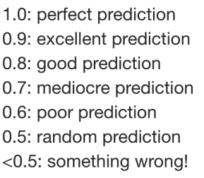
Is this accuracy ranking correct ?
Accuracy 0-1

Slide 14

Is this accuracy ranking correct ?
Accuracy 0-1
Accuracy of 90% for a credit card fraud detector model is bad.
Accuracy of 60% for a Stock Trading Model is excellent.

Slide 15
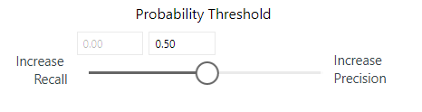
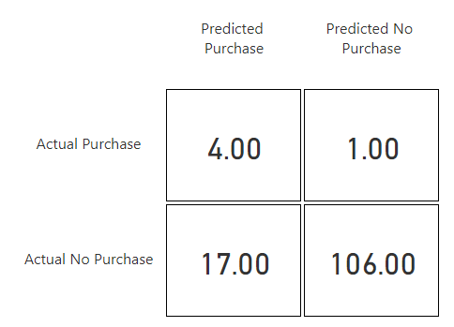

FP increase and FN decrease.
FN Increase and FP decrease.
TP
FN
FP
FN

Slide 16
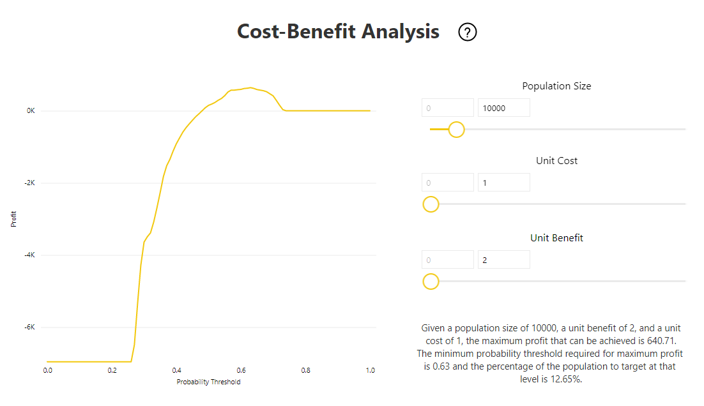
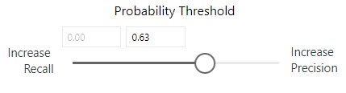

Slide 17
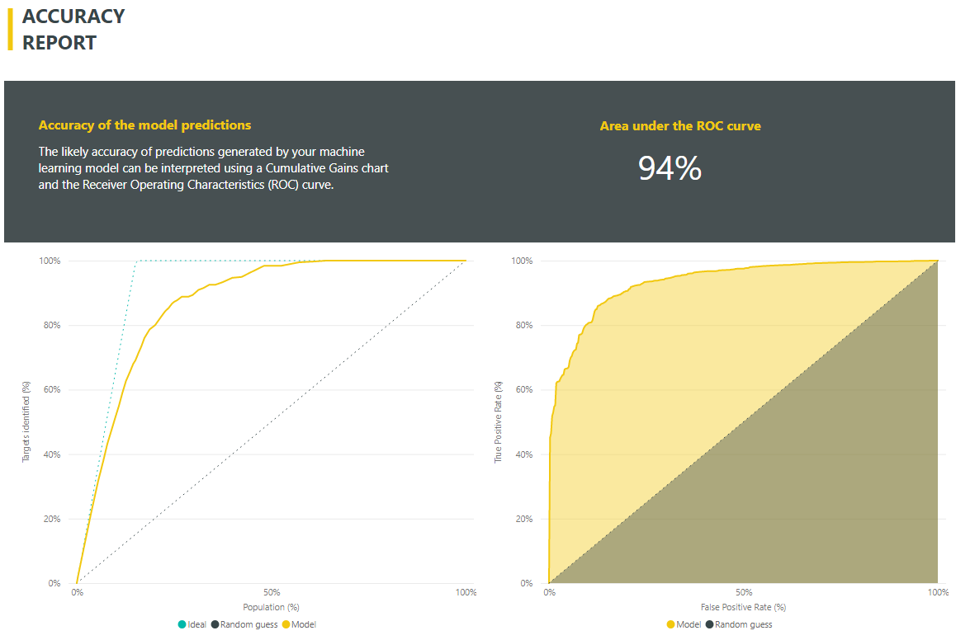
Receiver Operating Characteristics (ROC) curve
The closer the better
Sensitivity
1-Specificity

Slide 18

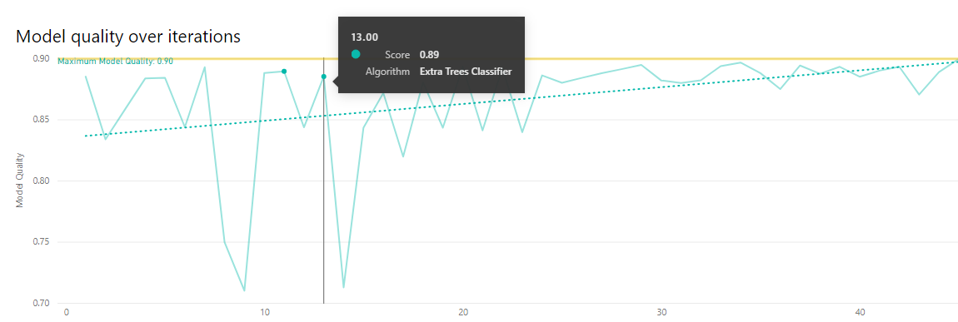

Slide 19
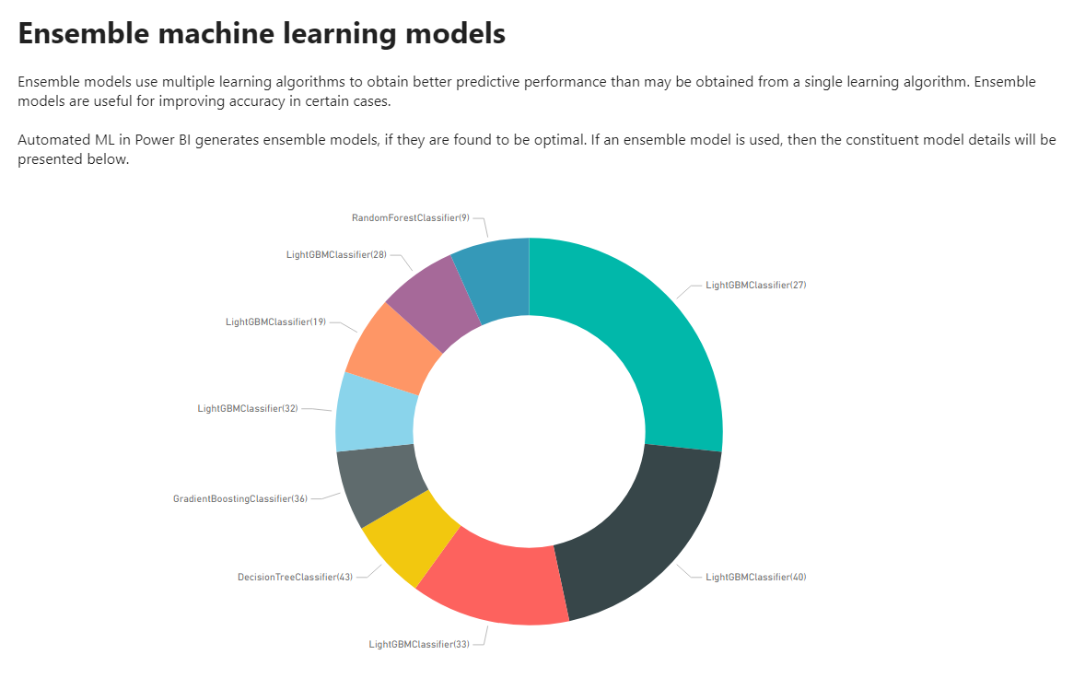

Slide 20
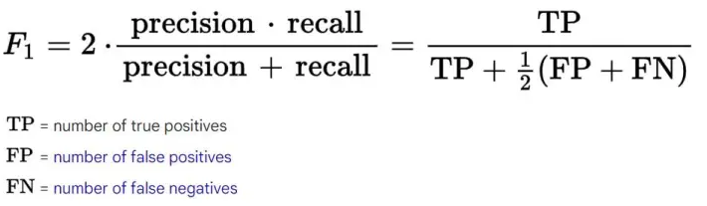
F1 score is defined as the harmonic mean between precision and recall.
https://www.kaggle.com/competitions/predict-student-performance-from-game-play/overview/efficiency-prize-evaluation

Slide 21
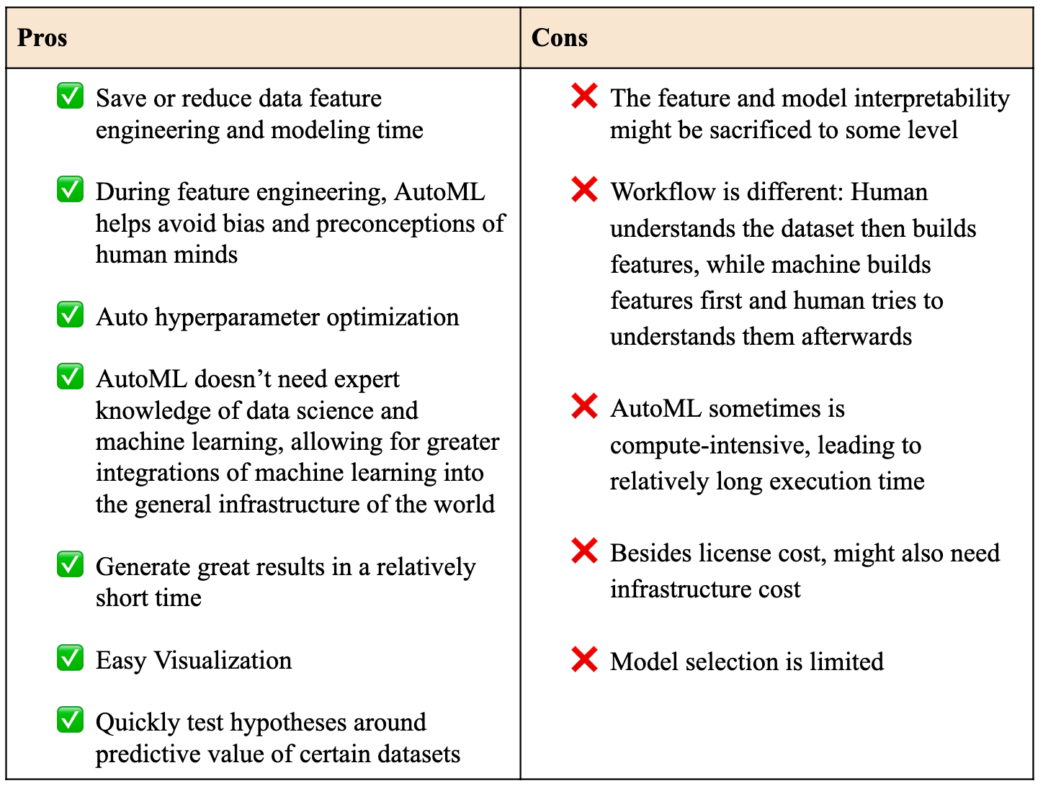
AutoML
https://www.kaggle.com/code/soham1024/know-about-different-automl-frameworks

Slide 22
Power BI AutoML resources:
Automated Machine Learning in Power BI
https://docs.microsoft.com/en-us/power-bi/service-machine-learning-automated
AutoML: Binary and Multinomial Classification Models
https://docs.microsoft.com/en-us/business-applications-release-notes/april19/business-intelligence/power-bi-service/pervasive-artificial-intelligence-bi/automl-binary-multinomial-classification-models

Slide 23
Thank you!
Hector Villafuerte
Blog: www.hectorv.com
E-mail: hectorvmail@gmail.com

